Slide 1

CERTIFICATE III IN AUTOMOTIVE REPAIR & MAINTENANCE
SUBJECT: BASIC WORKSHOP PRACTICE
By Ibrahim siraj
Maldives polytechnic

Slide 2
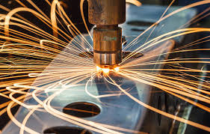
BASIC WORKSHOP PRACTICE
Module outlines / Unit name
Basic Workshop Practice
Module Code Number: BWP01
Credit, Learning Hours and contact hours
Credit: 8
Learning Hrs 80
Contact Hrs 40
Theory 40 Marks
Practical 60 Marks
By Ibrahim siraj
Maldives polytechnic

Slide 3
BASIC WORKSHOP PRACTICE
On completion of this module the student will be able to:
• Understand workshop safety, manual lifting methods
• Know and understand hand tools
• Know and understand and use gauges, marking and measuring tools
• Know bench vices, files and hacksaws
• Know chisels and hammers
• Know drills, taps, countersinking and dies
• Perform filing, Hacksawing and hammering operations
• Perform Chiseling, drilling, taping, countersinking and inside threading operations
By Ibrahim siraj
Maldives polytechnic

Slide 4
BASIC WORKSHOP PRACTICE
Understand workshop safety and manual lifting
What is workshop safety
Workshop safety refers to the practices, procedures, and rules designed to protect workers and prevent injuries in a workshop environment
A workshop can include places like mechanical shops, woodshops, metal shops, or labs.
By Ibrahim siraj
Maldives polytechnic

Slide 5
BASIC WORKSHOP PRACTICE
Workshop safety
Personal Protective Equipment (PPE): Wearing gear like gloves, safety glasses, helmets, and steel-toe boots
By Ibrahim siraj
Maldives polytechnic

Slide 6
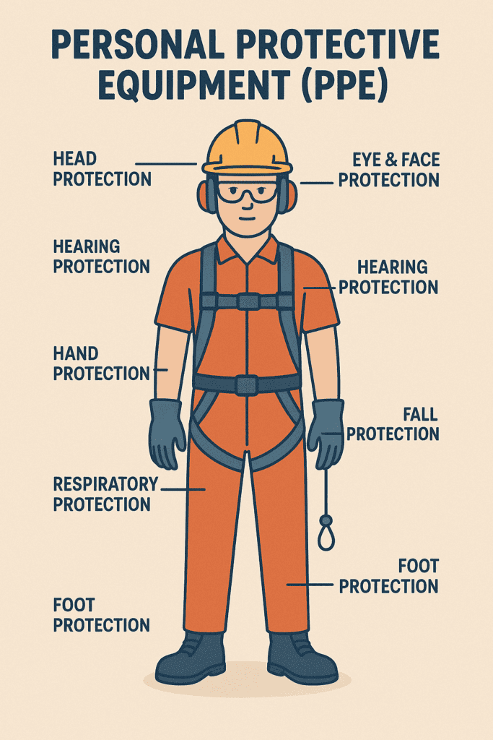
BASIC WORKSHOP PRACTICE
Head Protection
Eye and Face Protection
Hearing Protection
Hand Protection
Respiratory Protection
Foot Protection
Fall Protection
By Ibrahim siraj
Maldives polytechnic

Slide 7
BASIC WORKSHOP PRACTICE
Tool Safety: Ensuring tools and machines are properly maintained and used as intended.
Clean Environment: Keeping the workspace clean and free of hazards (like oil spills or scattered tools)
Proper Ventilation: Especially important in environments with dust, fumes, or chemicals
Fire Safety: Having extinguishers, knowing evacuation routes, and avoiding flammable materials near heat sources
Training: Workers must be trained to understand risks and use equipment safely
By Ibrahim siraj
Maldives polytechnic

Slide 8
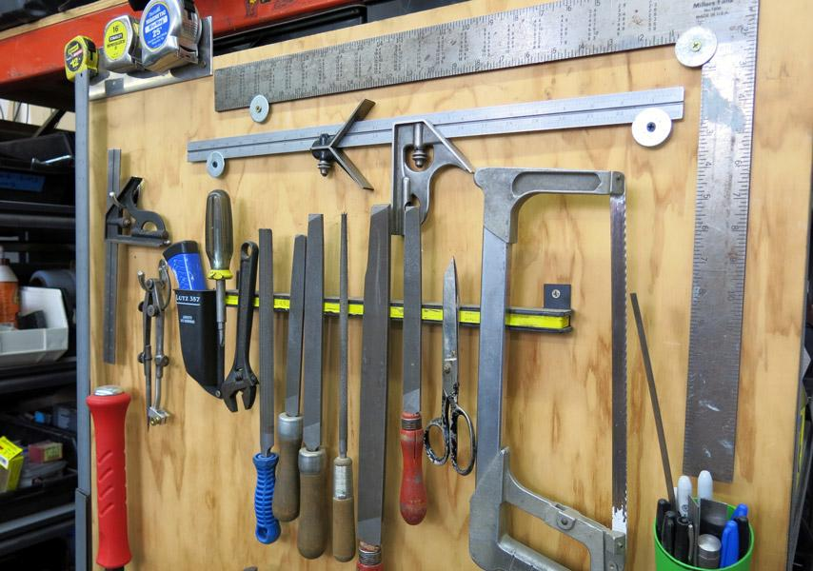
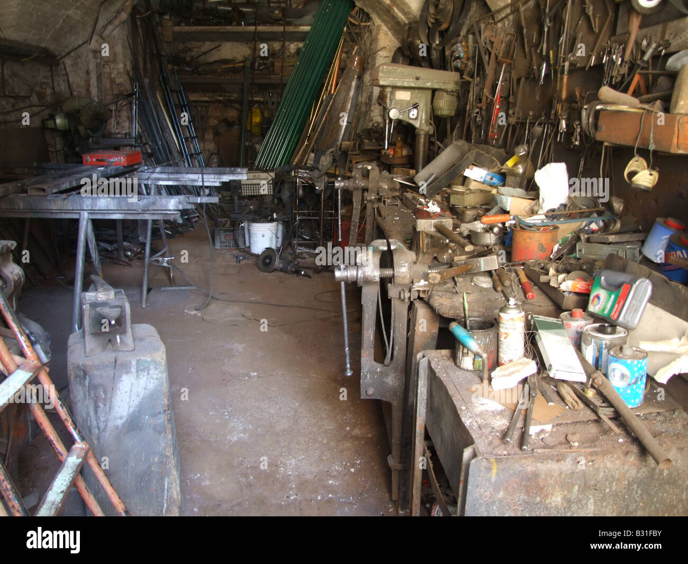
BASIC WORKSHOP PRACTICE
By Ibrahim siraj
Maldives polytechnic

Slide 9

BASIC WORKSHOP PRACTICE
Manual Lifting Methods
Manual lifting is when a person lifts, carries, pushes, or pulls an object without using machinery (like a forklift or crane). It's one of the most common causes of workplace injuries, especially back injuries
By Ibrahim siraj
Maldives polytechnic

Slide 10
BASIC WORKSHOP PRACTICE
Use Proper Lifting Technique
Stand close to the object.
Bend your knees, not your back.
Keep your back straight.
Grip firmly with both hands.
Lift smoothly using your leg muscles.
By Ibrahim siraj
Maldives polytechnic

Slide 11
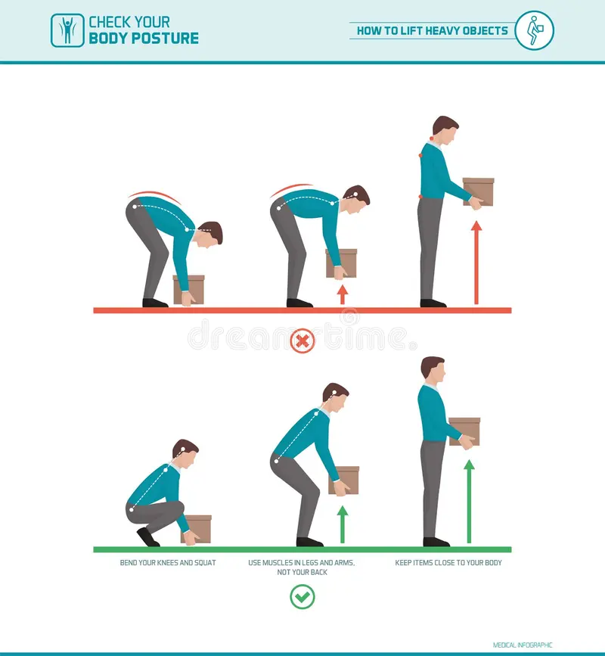
BASIC WORKSHOP PRACTICE
Muscle strains and sprain
Herniated disc
Hernias
Tendinitis and bursitis
Stress injuries
By Ibrahim siraj
Maldives polytechnic

Slide 12
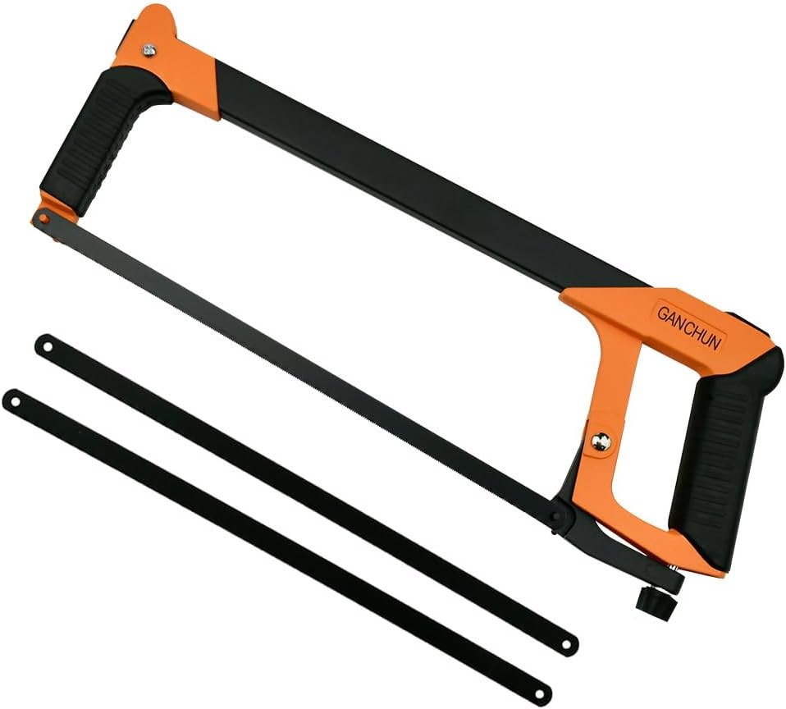
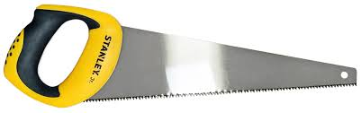
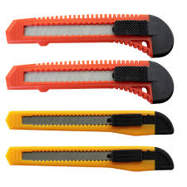
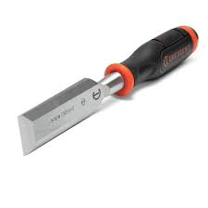
BASIC WORKSHOP PRACTICE
2 Know and Understand Hand Tools
1. Cutting Tools
Used to cut or shape materials like metal, wood, or plastic.
Hacksaw – For cutting metal or plastic pipes and rods.
Handsaw – For cutting wood.
Utility Knife (Box Cutter) – For trimming, slicing, or scoring materials.
Chisels – For carving or cutting hard materials like wood or metal.
By Ibrahim siraj
Maldives polytechnic

Slide 13
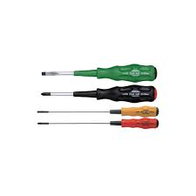
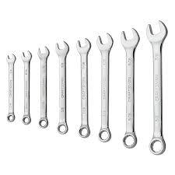
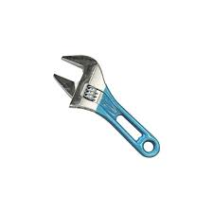
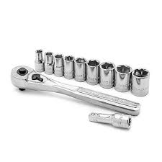
BASIC WORKSHOP PRACTICE
2. Fastening and Loosening Tools
Used to drive in or remove screws, nuts, and bolts.
Screwdrivers – Flathead, Phillips, Torx, etc., used for driving screws
Wrenches (Spanners) – Used for gripping and turning nuts and bolts.
Types: Adjustable wrench, Combination wrench, Socket wrench
By Ibrahim siraj
Maldives polytechnic

Slide 14
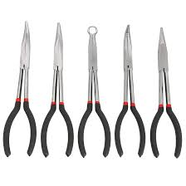
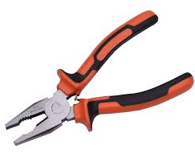
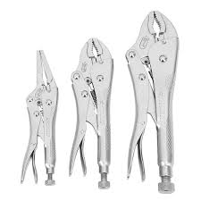
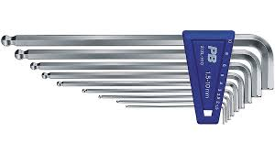
BASIC WORKSHOP PRACTICE
2. Fastening and Loosening Tools
Pliers – For gripping, twisting, and cutting wires or small components.
Types: Needle-nose pliers, combination pliers, locking pliers.
Allen (Hex) Keys – For hexagonal socket screws.
By Ibrahim siraj
Maldives polytechnic

Slide 15
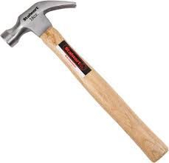
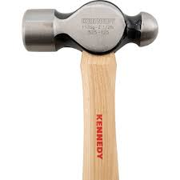
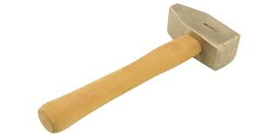
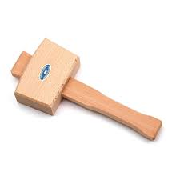
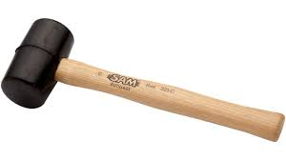
BASIC WORKSHOP PRACTICE
3. Striking Tools Used to apply force
Hammer – For driving nails or breaking objects etc.
Types: Claw hammer, ball-peen hammer, sledgehammer.
Mallet – A softer hammer used for delicate tasks or materials (e.g., woodworking).
By Ibrahim siraj
Maldives polytechnic

Slide 16
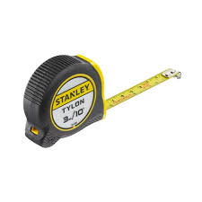
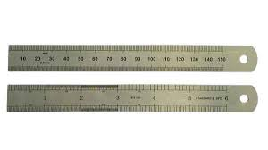
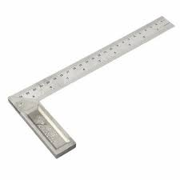
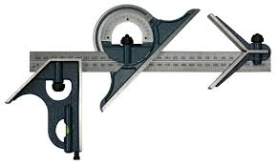
BASIC WORKSHOP PRACTICE
4. Measuring and Marking Tools
For accurate measurement and layout work.
Tape Measure – For measuring length or distance.
Ruler or Steel Rule – For precise straight-line measurements
Square (Try Square, Combination Square) – For checking right angles
Marking Gauge / Scriber / Pencil – For marking cut lines or drill points.
By Ibrahim siraj
Maldives polytechnic

Slide 17
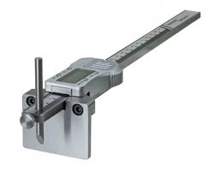
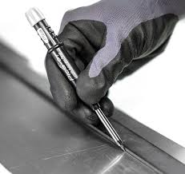
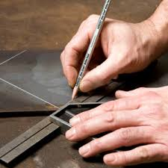
BASIC WORKSHOP PRACTICE
4. Measuring and Marking Tools
Marking Gauge / Scriber / Pencil – For marking cut lines or drill points.
By Ibrahim siraj
Maldives polytechnic

Slide 18
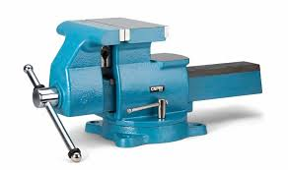
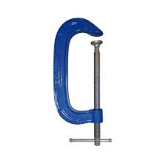
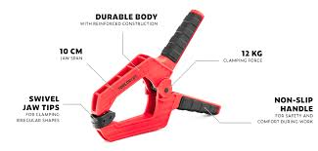
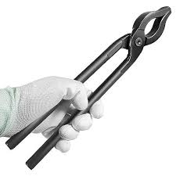
BASIC WORKSHOP PRACTICE
5. Gripping and Holding Tools Used to hold objects securely during work.
Bench Vise – Mounted to a workbench to hold workpieces firmly.
Clamps – Temporary holders to secure materials during cutting or gluing.
Types: G-clamp, bar clamp, spring clamp.
Tongs – For handling hot or hazardous materials.
By Ibrahim siraj
Maldives polytechnic

Slide 19
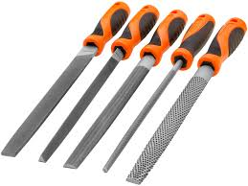
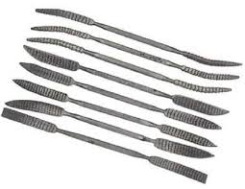
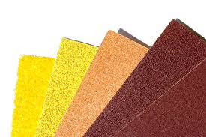
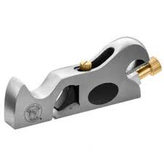
BASIC WORKSHOP PRACTICE
6. Shaping and Finishing Tools Used to smooth or shape materials.
Files and Rasps – For smoothing metal or wood.
Sandpaper / Sanding Block – For surface finishing.
Hand Planes – For smoothing and shaping wood surfaces.
By Ibrahim siraj
Maldives polytechnic

Slide 20
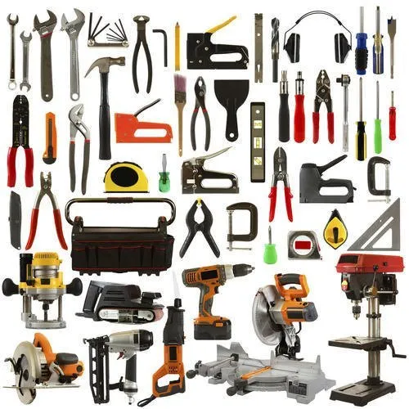
BASIC WORKSHOP PRACTICE
By Ibrahim siraj
Maldives polytechnic

Slide 21
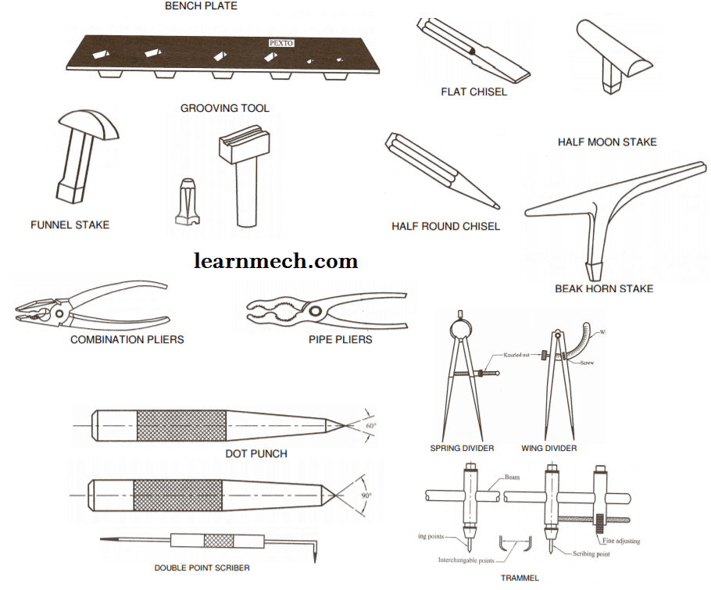
BASIC WORKSHOP PRACTICE
3- Know and understand gauges, marking and measuring tools.
By Ibrahim siraj
Maldives polytechnic

Slide 22
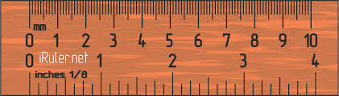
BASIC WORKSHOP PRACTICE
3- Know and understand gauges, marking and measuring tools.
By Ibrahim siraj
Maldives polytechnic

Slide 23
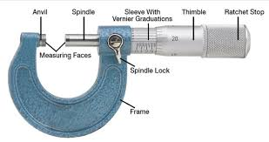
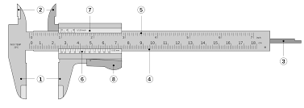
BASIC WORKSHOP PRACTICE
3- Know and understand gauges, marking and measuring tools.
By Ibrahim siraj
Maldives polytechnic

Slide 24
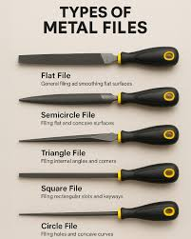
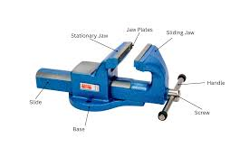
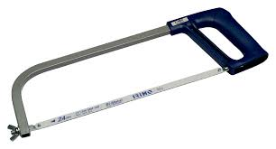
BASIC WORKSHOP PRACTICE
4- Bench Vice Files And Hacksaw.
By Ibrahim siraj
Maldives polytechnic

Slide 25
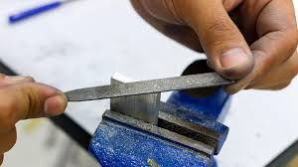
BASIC WORKSHOP PRACTICE
4- Bench Vice Files And Hacksaw.
By Ibrahim siraj
Maldives polytechnic

Slide 26
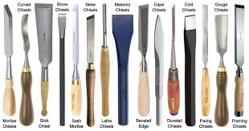
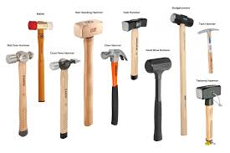
BASIC WORKSHOP PRACTICE
5- Chisels and hammers
By Ibrahim siraj
Maldives polytechnic

Slide 27
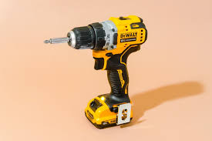
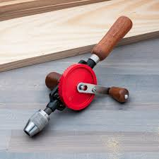

BASIC WORKSHOP PRACTICE
6- Drills, Taps, Countersinking And Dies
By Ibrahim siraj
Maldives polytechnic

Slide 28


BASIC WORKSHOP PRACTICE
6- Drills, Taps, Countersinking And Dies
By Ibrahim siraj
Maldives polytechnic

Slide 29

BASIC WORKSHOP PRACTICE
6- Drills, Taps, Countersinking And Dies
Counter sinking
After drilling a straight pilot hole, the countersink bit is used to create a conical shape at the hole's opening
By Ibrahim siraj
Maldives polytechnic

Slide 30

BASIC WORKSHOP PRACTICE
6- Drills, Taps, Countersinking And Dies
Drilling
Drilling Machine Parts:
Drilling Machine consists of the following Main Parts:
Bed
Pillar
Swivel table
Motor
Steeped pulley
Spindle
Chuck
Drill Bit and
Hand-wheel.
By Ibrahim siraj
Maldives polytechnic

Slide 31
BASIC WORKSHOP PRACTICE
6- Drills, Taps, Countersinking And Dies
Drilling
For drilling mild steel with a High-Speed Steel (HSS) bit, use a slow speed, typically ranging from 300 to 1000 RPM depending on the bit diameter. Larger bits require slower RPMs (e.g., 350 RPM for 25mm), while smaller bits can go faster (e.g., 1000 RPM for 6mm). Use cutting oil to prevent overheating.
By Ibrahim siraj
Maldives polytechnic

Slide 32

BASIC WORKSHOP PRACTICE
6- Drills, Taps, Countersinking And Dies
Drilling
The formula differs depending on whether you are using metric or imperial units:
Metric Formula (mm):
RPM=$\frac{VC X 1000}{π X D}$
: Cutting Speed (meters per minute, m/min). For mild steel, this is typically 30–35 m/min.
: Diameter of the drill bit (mm).
: Approximately 3.14
By Ibrahim siraj
Maldives polytechnic

Slide 33
BASIC WORKSHOP PRACTICE
6- Drills, Taps, Countersinking And Dies
Drilling
Key Factors for Success
Lubrication: Use cutting oil or fluid to prevent the bit from overheating. If drilling dry, reduce the calculated RPM by about 40%.
Heat Check: If the chips coming off the metal are blue or the bit starts smoking, your speed is too high; slow down immediately to avoid dulling the bit.
Deep Holes: If the hole is deeper than 3–4 times the drill's diameter, reduce the speed and feed rate by 25–50% and use "peck drilling" (withdrawing the bit periodically to clear chips).
Tool Material: The formulas above are for standard HSS bits. If using Cobalt bits, you can maintain these speeds for longer; for Carbide bits, you can often run 2–3 times faster
By Ibrahim siraj
Maldives polytechnic

Slide 34
THANK YOU

